Slide 1

EDA CASE STUDY SOLUTION
By Deepak A

Slide 2
INTRODUCTION-
This case study aims to give you an idea of applying EDA in a real business scenario. In this case study, apart from applying the techniques that you have learnt in the EDA module, you will also develop a basic understanding of risk analytics in banking and financial services and understand how data is used to minimize the risk of losing money while lending to customers.

Slide 3
BUSINESS UNDERSTANDING - 1
The loan providing companies find it hard to give loans to the people due to their insufficient or non-existent credit history. Because of that, some consumers use it as their advantage by becoming a defaulter. Suppose you work for a consumer finance company which specialises in lending various types of loans to urban customers. You have to use EDA to analyse the patterns present in the data. This will ensure that the applicants capable of repaying the loan are not rejected. • When the company receives a loan application, the company has to decide for loan approval based on the applicant’s profile. Two types of risks are associated with the bank’s decision: • If the applicant is likely to repay the loan, then not approving the loan results in a loss of business to the company • If the applicant is not likely to repay the loan, i.e., he/she is likely to default, then approving the loan may lead to a financial loss for the company

Slide 4
BUSINESS UNDERSTANDING - 2
The data given below contains the information about the loan application at the time of applying for the loan. It contains two types of scenarios: • The client with payment difficulties: he/she had late payment more than X days on at least one of the first Y instalments of the loan in our sample, • All other cases: All other cases when the payment is paid on time. When a client applies for a loan, there are four types of decisions that could be taken by the client/company): 1. Approved: The Company has approved loan Application 2. Cancelled: The client cancelled the application sometime during approval. Either the client changed her/his mind about the loan or in some cases due to a higher risk of the client he received worse pricing which he did not want. 3. Refused: The company had rejected the loan (because the client does not meet their requirements etc.). 4. Unused offer: Loan has been cancelled by the client but on different stages of the process. In this case study, we will use EDA to understand how consumer attributes and loan attributes influence the tendency of default.

Slide 5
BUSINESS OBJECTIVES
This case study aims to identify patterns which indicate if a client has difficulty paying their instalments which may be used for taking actions such as denying the loan, reducing the amount of loan, lending (to risky applicants) at a higher interest rate, etc. This will ensure that the consumers capable of repaying the loan are not rejected. Identification of such applicant's using EDA is the aim of this case study. • In other words, the company wants to understand the driving factors (or driver variables) behind loan default, i.e., the variables which are strong indicators of default. The company can utilize this knowledge for its portfolio and risk assessment. • To develop your understanding of the domain, you are advised to independently research a little about risk analytics - understanding the types of variables and their significance should be enough)

Slide 6
DATA UNDERSTANDING
This dataset has 3 files as explained below: • 1. 'application_data.csv' contains all the information of the client at the time of application. The data is about whether a client has payment difficulties. • 2. 'previous_application.csv' contains information
about the client’s previous loan data. It contains the data whether the previous
application had been Approved, Cancelled, Refused or Unused offer. • 3. 'columns_description.csv' is data dictionary which describes the meaning of the variables.

Slide 7

Outlier
analysis
Analysis of information of the client at the time of application

Slide 8
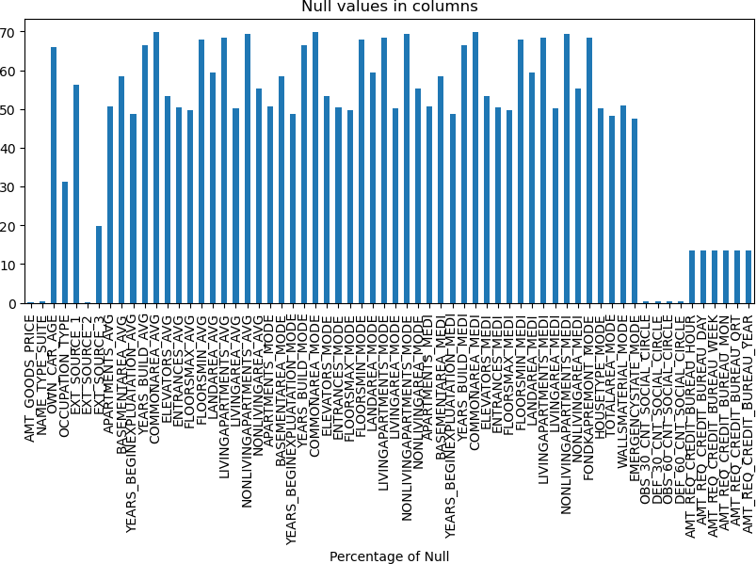
Visualizing Null values of columns in graph

Slide 9
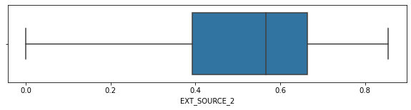
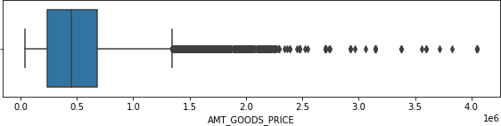
Continuous variable
Observation from Boxplots:
For 'EXT_SOURCE_2' no outliers present. So data is rightly present. For 'AMT_GOODS_PRICE' outlier present
in the data. so need to impute with median value: 4
From the above we can see that first two (EXT_SOURCE_2, AMT_GOODS_PRICE) are continuous variables and remaining are categorical variables

Slide 10
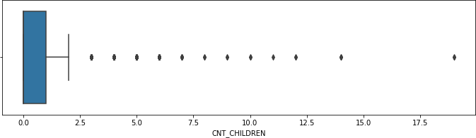
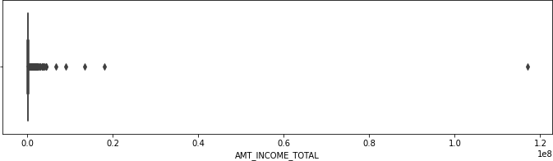
check box plot for 'CNT_CHILDREN', 'AMT_INCOME_TOTAL','AMT_CREDIT','AMT_ANNUITY','DAYS_EMPLOYED', 'DAYS_REGISTRATION'
1st quartile is missing for CNT_CHILDREN which means most of the data are present in the 1st quartile.

Slide 11
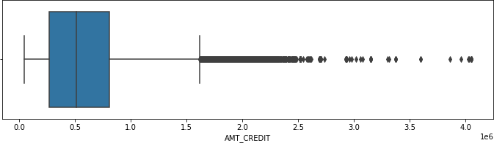
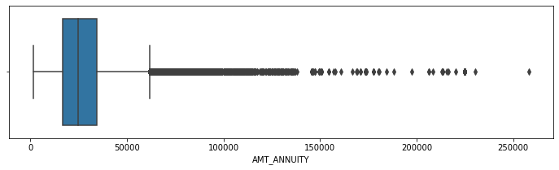
In AMT_INCOME_TOTAL only single high value data point is present as outlier
AMT_CREDIT has little bit more outliers

Slide 12
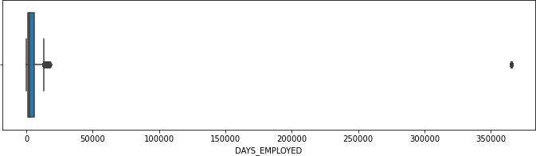
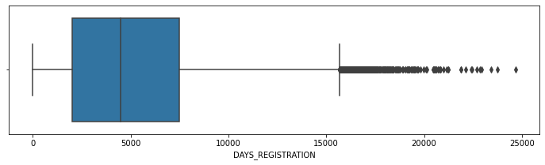
1st quartiles and 3rd quartile for AMT_ANNUITY is moved towards first quartile.
Same with this too 1st quartiles and 3rd quartile for DAYS_EMPLOYED is stays first quartile.

Slide 13
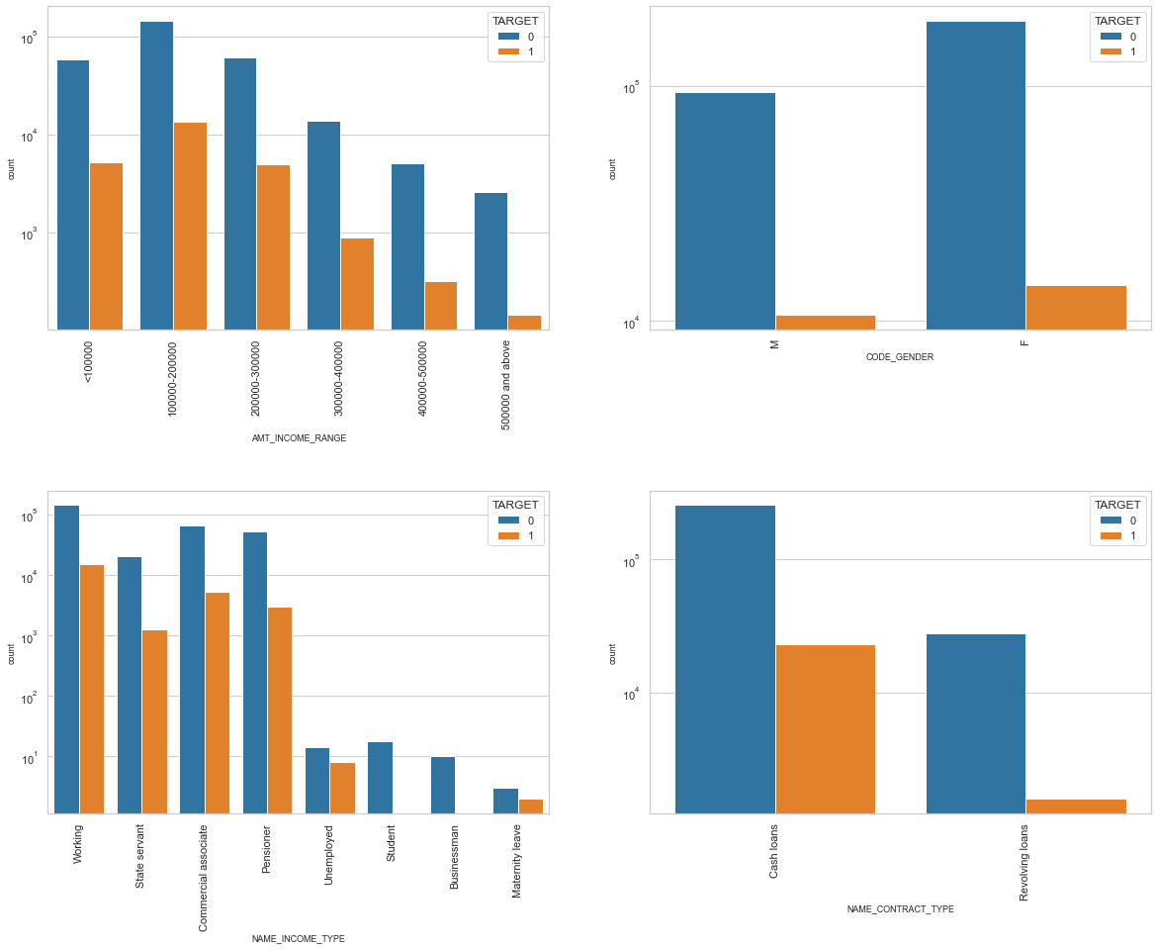
Univariate Analysis

Slide 14
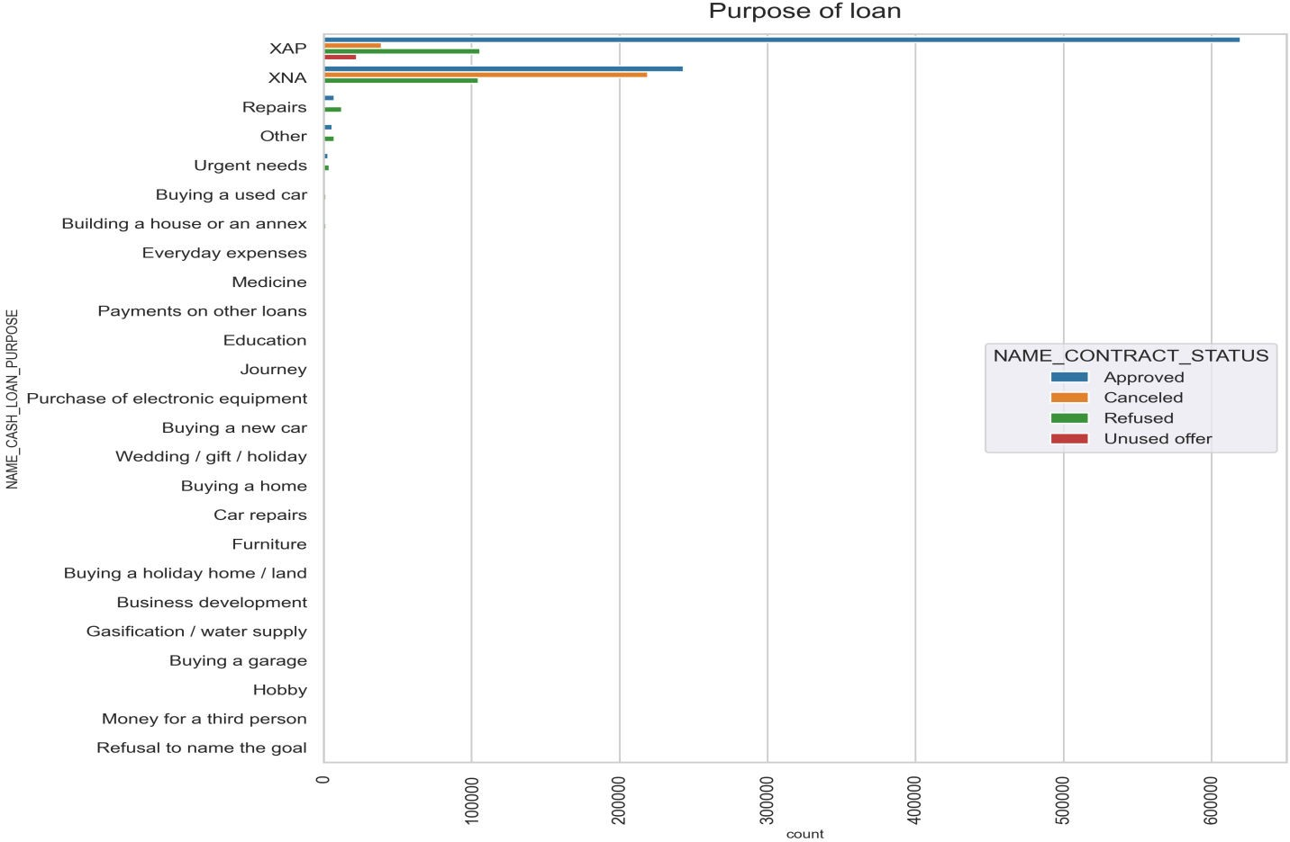
Performing univarite analysis
-PURPOSE OF LOAN
Observation
Most of loan rejection was from 'repairs'

Slide 15
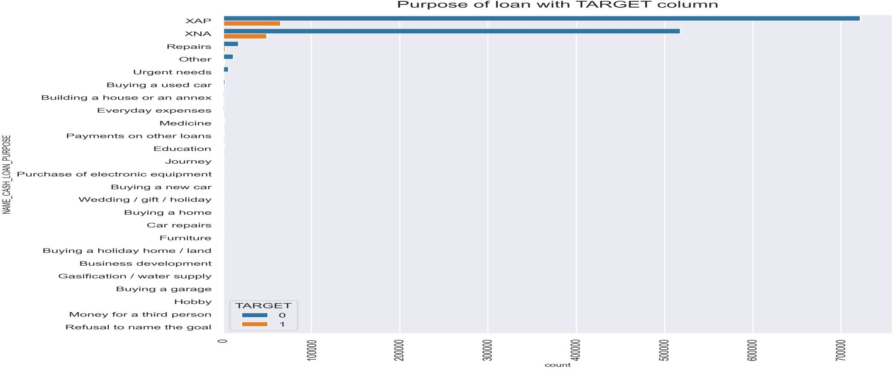
Purpose of loan with TARGET column

Slide 16
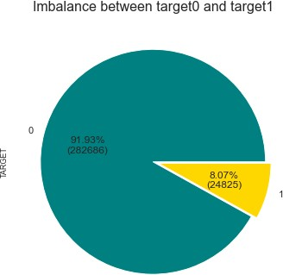
Calculating Imbalance percentage for target 0 and target 1.
Visualizing the above result in a pie plot
Inferences
8.78% of clients are clients with payment difficulties. 91.21% of clients fall under the 'all other cases' category.

Slide 17
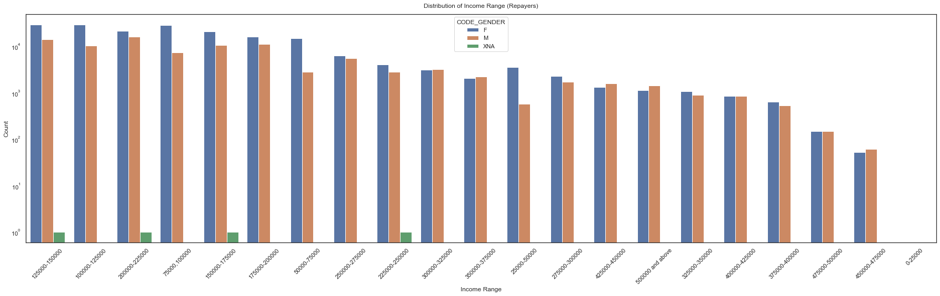
Plotting graphs for Target0 (Customers with no payment difficulties)
Inferences
In majority of the cases, female counts are higher than male.
Income range from 100000 to 200000 is having more number of credits.
In the slots 250000-275000 and 375000-400000, the count for both males and females are almost the same

Slide 18
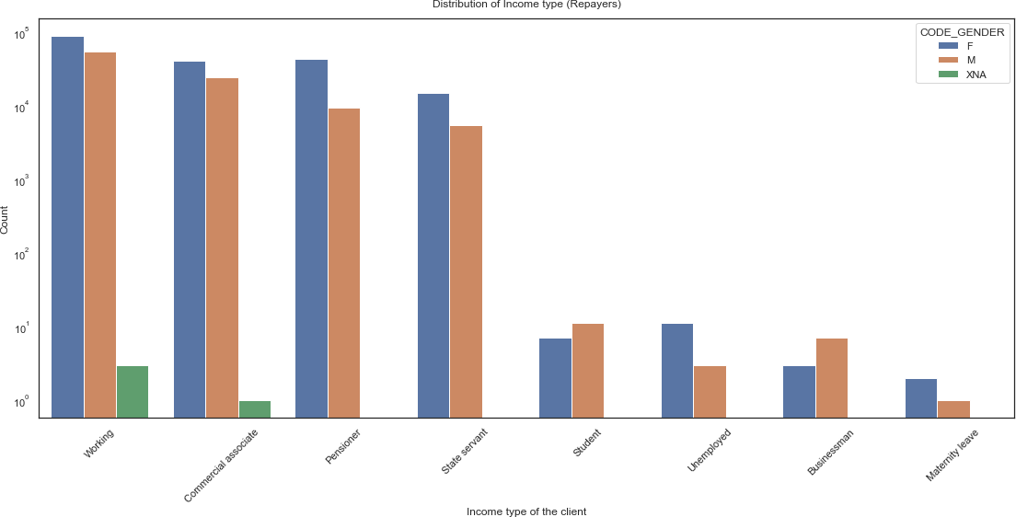
Plotting for Income type (NAME_INCOME_TYPE) (Segregated based on gender)
1. Working people make up most of the clients. 2.
Gender distribution amongst students is almost the same. 3. There is a stark decrease in the number of clients if they are not working, commercial associate or state servants. 4. There are more female clients in the top 3 categories of income type.
Inferences

Slide 19
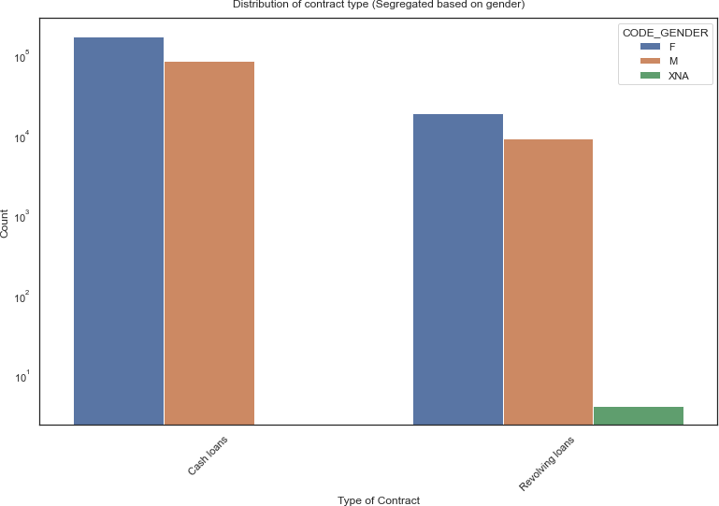





Plotting for Contract type (NAME_CONTRACT_TYPE) (Segregated based on gender)
Cash loans clearly has more clients per credit compared to revolving loans. In both cases, there are female clients than male clients.
Inferences

Slide 20
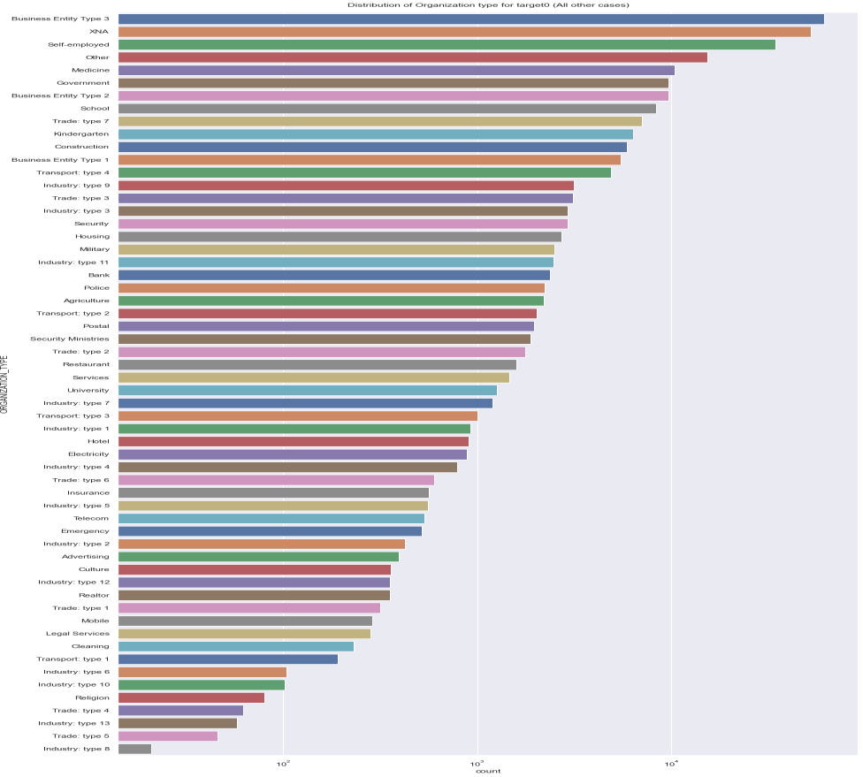
Plotting for Organization type in logarithmic scale
Inferences
Clients which have applied for credits are from most of the organization type ‘Business entity Type 3’ , ‘Self employed’, ‘Other’ , ‘Medicine’, ‘Government’ and 'Business entity type2'.

Slide 21
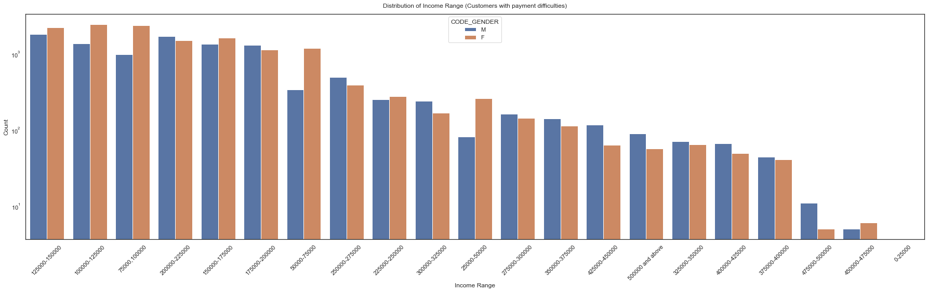
Plotting graphs for Target1 (Customers with payment difficulties)¶
Plotting graphs for Target1 (Customers with payment
difficulties)¶
Inferences
1.Income range from 100000 to 200000 is having the highest number of credits. 2.Very less count for income range 400000 and above.
3.On average, there are more number of male clients where the number of credits are less.

Slide 22
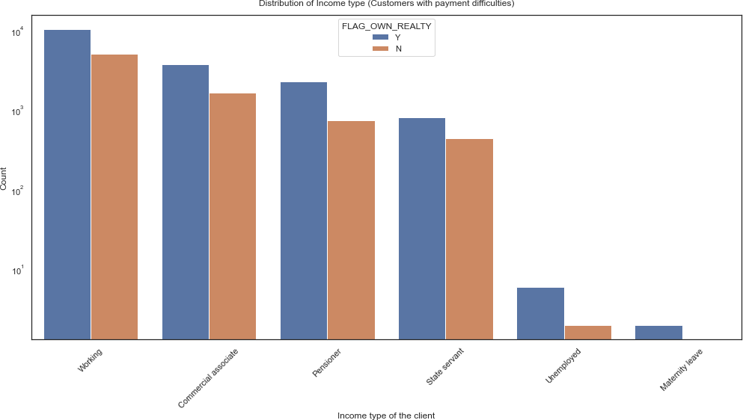
Plotting for Income type (Segregated based on house
Inferences
Working customers, obviously, have a higher count.
As we can see, most customers do have their own property (house or a flat) but a large number of customers can be stated as otherwise.

Slide 23
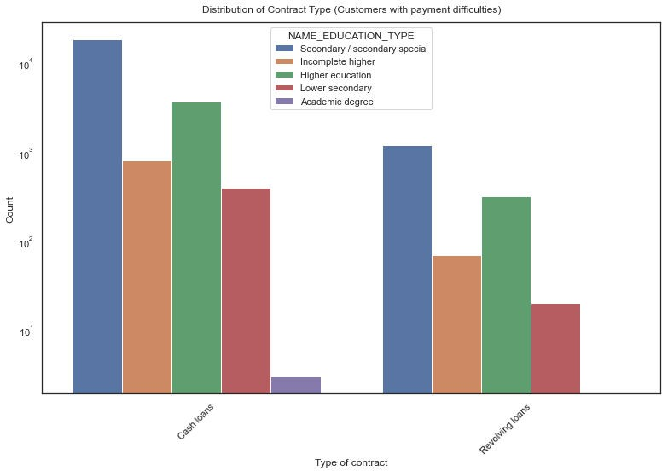
Plotting for Contract type (Segregated based on education level)
Inferences
Cash loans, as we can see, are preferred by clients of all education backgrounds with an overwhelming majority.
People with only an academic
degree do not prefer revolving
loans at all.
1

Slide 24
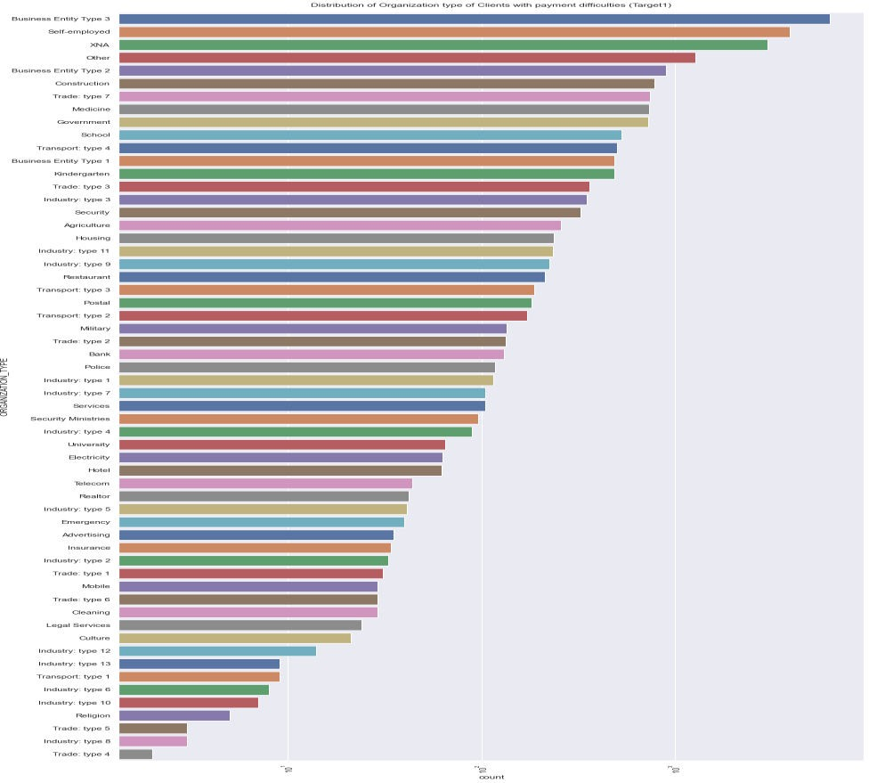
Plotting for Organization type
Inferences
As compared to the clients with NO payment difficulties, clients WITH payment difficulties have the 'construction' business type in the top 5 count replacing the 'medicine' business type.
Most of the business types are the same as clients with NO payment difficulties, except we have the business type 'Transport: type1' in the case of clients WITH payment difficulties which wasn't present before.

Slide 25
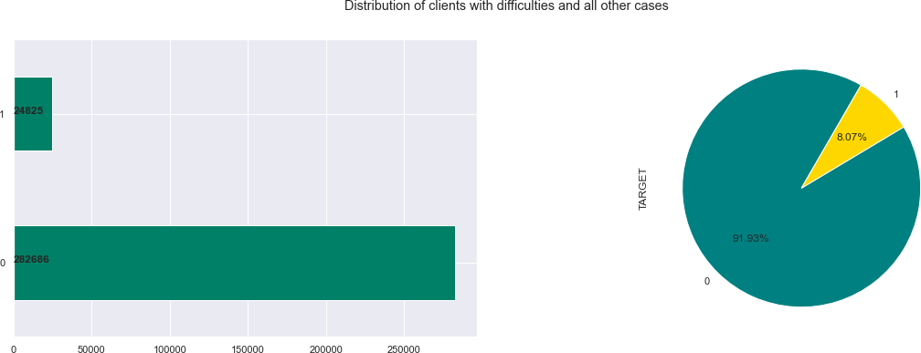
More Analysis to find patter¶ ns:
Distribution of Target variable¶
Target variable: 1 - client with payment difficulties
0 - all other cases
Inferences
8.79% (18547) out of total
client population (192573) have difficulties in repaying loans.

Slide 26
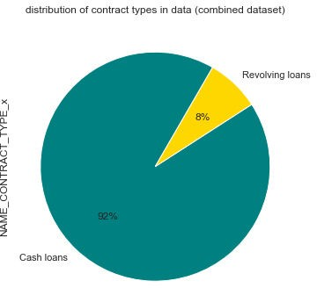
Distribution in Contract types in data (Combined dataset)
Inferences
The percentage of revolving loans and cash loans are 8% &
92%.

Slide 27
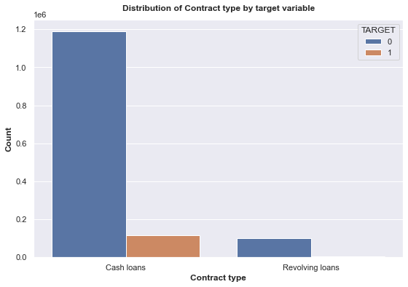
Point to infer from the graph
In the applicationData file, we saw females had 61% and males had 39% but now in the combined
dataset we see:- Females: 62% Males: 38%
Distribution of Contract type by target (repayment status)
Inferences
Both set of clients (Target 0 and target 1) prefer cash loans over revolving loans with overwhelming numbers

Slide 28
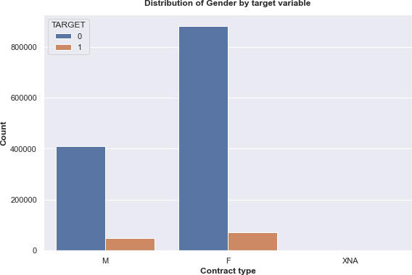
Distribution of Gender by target (repayment status)
Inferences
Clearly, female clients are the best repayers of their loan (almost double the amount of males).
Amount of defaulters in both genders are almost equally distributed.

Slide 29
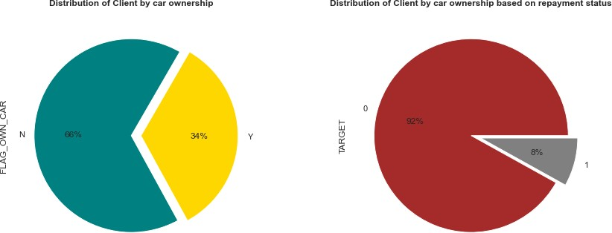
Distribution of client owning a car and by target.
Inferences
1st pie plot : Only 38% of clients own a car .2nd pie plot : Only 8% of clients who own a car have difficulty in
payments

Slide 30
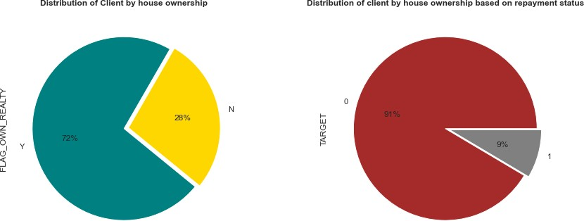
Distribution of client owning a house or flat and by target
Inferences
SUBPLOT 1 : 71% of clients own a house or a flat.SUBPLOT 2 : Out of all the clients who own a house,
9% of clients have difficulty in making payments.

Slide 31
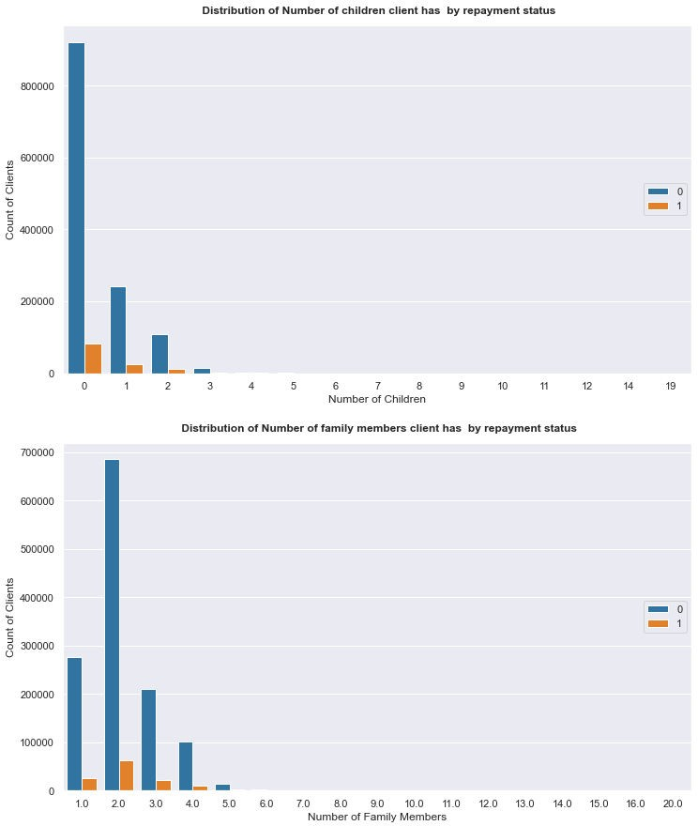
Distribution of Number of children and family members of client by repayment status (Based on target).
Inferences
Subplot1:
The majority as per both cases of repayment status, have zero
children.
Clients with more than 2 children do not have difficulty in making payments.
Clients with 0 children have the majority in terms of having difficulty in making payments.
Subplot2:
Clients with 2 family members living together are in high numbers as per both cases of repayment status
Also, from point 1, the majority of clients having difficulty in payments have 2 family members

Slide 32
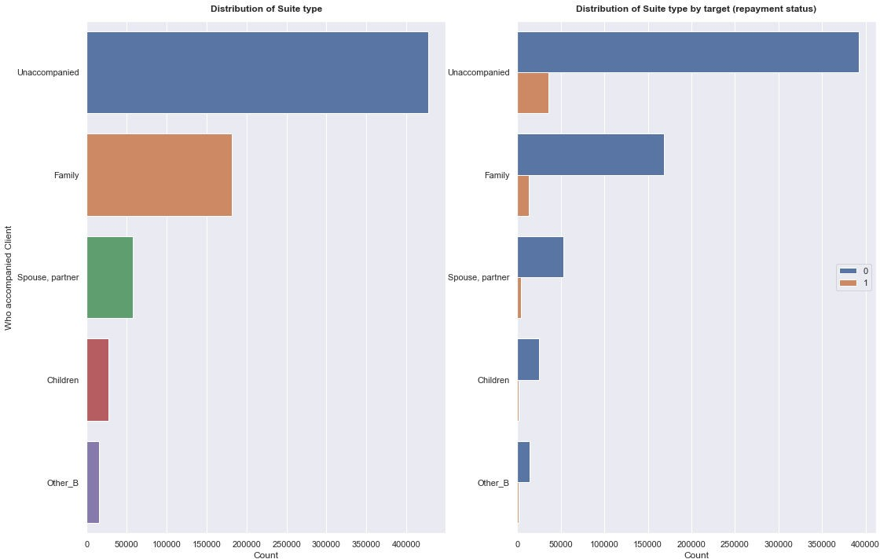
Distribution of Suite type
Inferences
Note: Missing data was labelled as 'missing' during the data cleaning process so we can ignore it. of the clients are (in both cases of repayment status) unaccompanied (without anyone to help/guide them)
Least amount of clients are in the company of their children.

Slide 33
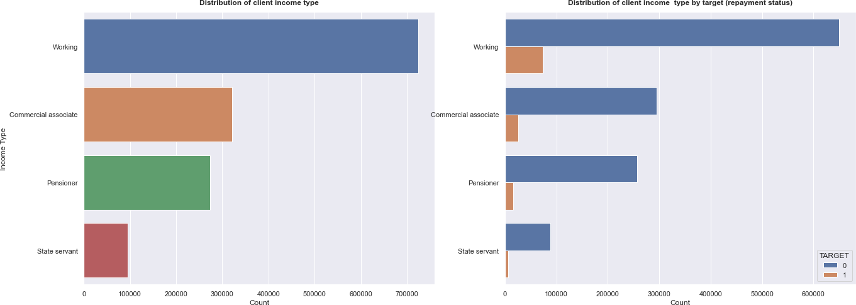
Distribution of client income type
Inferences
Most clients as per both cases of repayment status, are working.
Conversely, the least amount of clients are pensioners (retired clients)

Slide 34
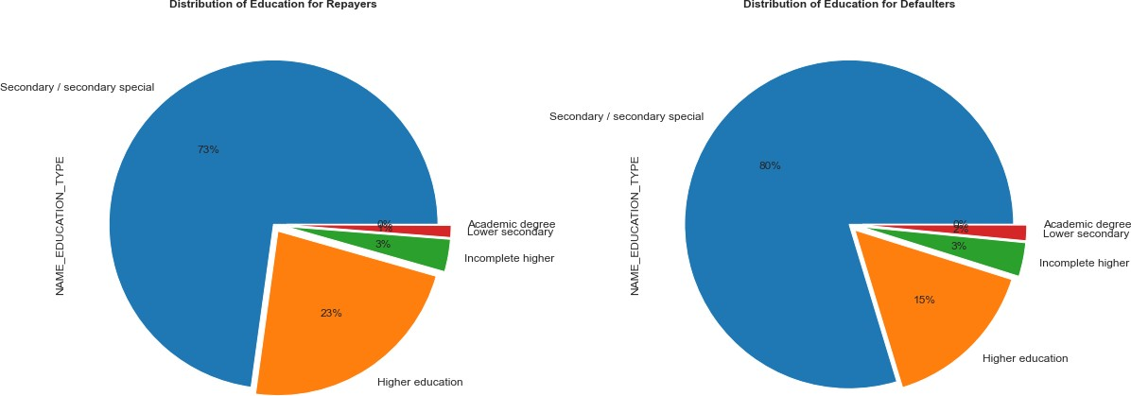
Distribution of Education type by repayment status
Point to infer from the graph 1.Clients who default are proportionally 9% higher compared to clients who do not default (for clients with education as secondary).
In the higher education category, clients who default are 8% fewer.
In both cases of repayment status, lower secondary and academic degree categories are the minority.

Slide 35
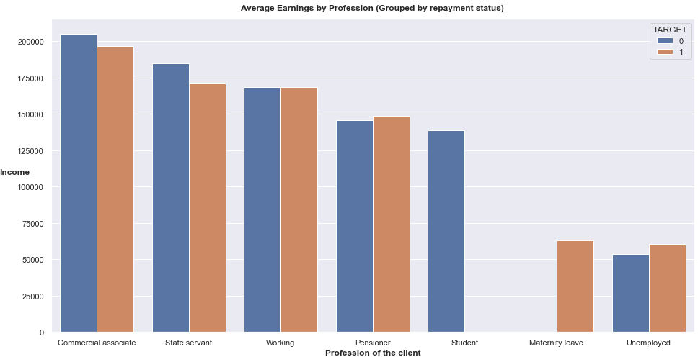
Average Earnings by different professions based on target (repayment status)
Inferences
In both cases of repayment status, commerical associate clients are the highest earners.
Clients who are on maternity leave (therefore, female clients) have difficulty in making payments 3. Pensioners and students do not have any
difficulties in repayments. 4. There are almost an equal number of clients under the working category who repay and default.

Slide 36
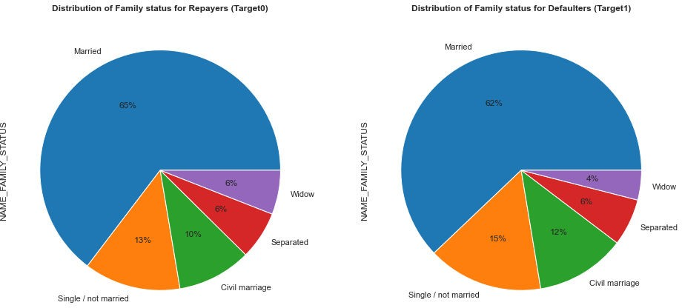
Distribution of Education type by loan repayment status
Inferences
There's a difference of
-4% in married clients who have difficulty in making payments.
Family status for both cases of repayment status have an almost evenly distributed family status (family members living with the client)

Slide 37
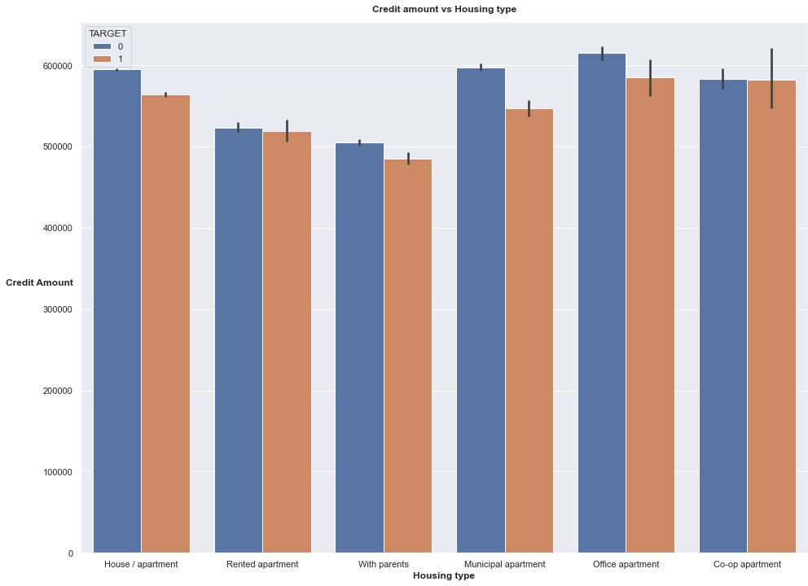
Distribution of credit amount and housing type
Inferences 1.Clients with office, co-op, municipal apartments have the highest repayers.
2.Clients living with parents or in a parents' apartment have the least amount of repayers and defaulters.

Slide 38
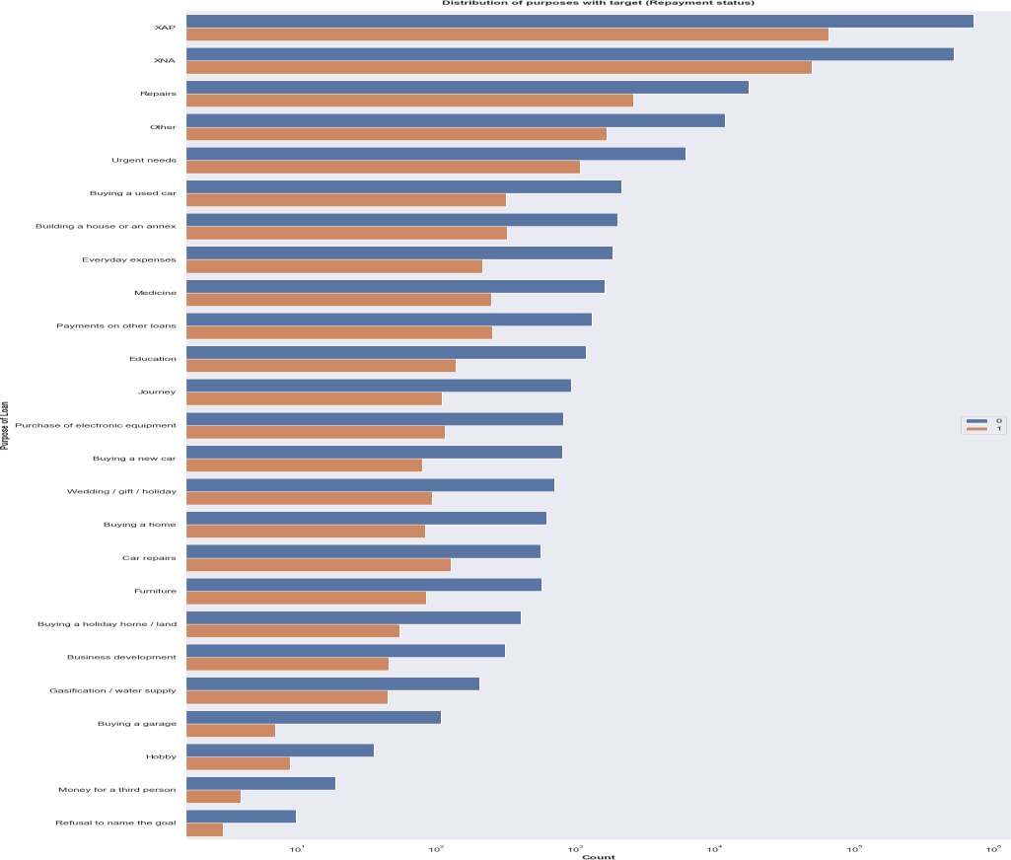
Distribution of Loan purpose (Segregated by repyament status (Target))
Inferences
1.Repair purposes are on top with most defaulters and repayers. 2.Proportion wise, there are high amount of repayers when the client refuses to name the purpose of the loan. Although such clients are rare.

Slide 39
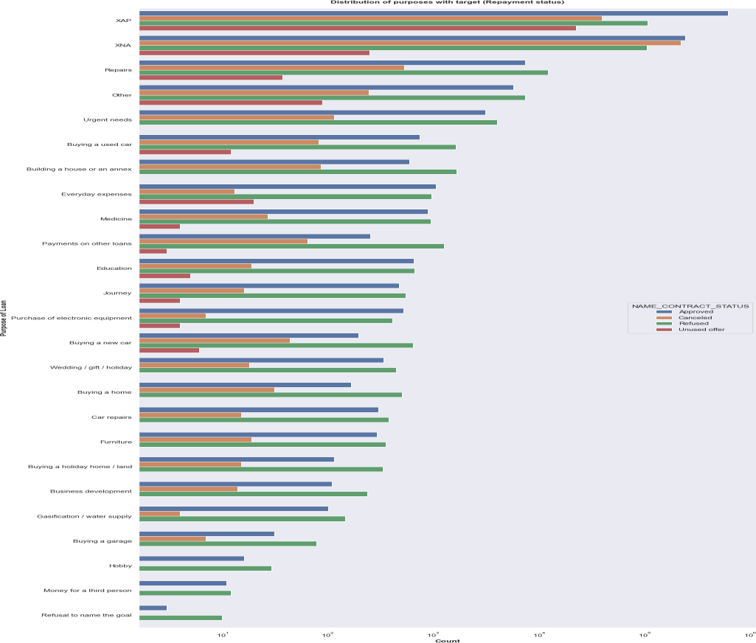
Distribution of contract status
Inferences
1. Most rejection of loans is when the purpose of the client is based on Repairs. 2. For education purposes we have equal number of approvals and
refusals.

Slide 40
TOP10 Correlation variables
From the above output, the top10 correlated columns are:
(double click to view in proper format)
OBS_30_CNT_SOCIAL_CIRCLE OBS_60_CNT_SOCIAL_CIRCLE 1.00
AMT_CREDIT_y AMT_APPLICATION 0.97
DAYS_TERMINATION DAYS_LAST_DUE 0.93
CNT_FAM_MEMBERS CNT_CHILDREN 0.90
REG_REGION_NOT_WORK_REGION LIVE_REGION_NOT_WORK_REGION 0.88
DEF_30_CNT_SOCIAL_CIRCLE DEF_60_CNT_SOCIAL_CIRCLE 0.87
AMT_GOODS_PRICE_y AMT_CREDIT_y 0.86
AMT_APPLICATION AMT_GOODS_PRICE_y 0.85
REG_CITY_NOT_WORK_CITY LIVE_CITY_NOT_WORK_CITY
0.83
AMT_CREDIT_y AMT_ANNUITY_y 0.81

Slide 41
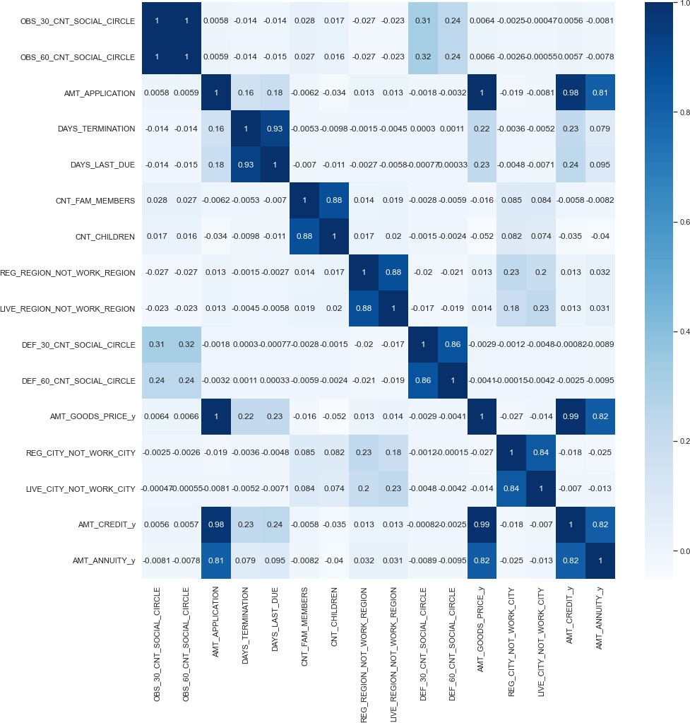
Visually showcasing the top10 correlated columns through a heatmap¶
Inferences
1. AMT_GOODS_PRICE and AMT_APPLICATION have a high correlation, which means the more credit the client asked for previously is proportional to the goods price that the client asked for previously. 2. AMT_ANNUITY and AMT_APPLICATION also have a high correlation, which means the higher the loan annuity issued, the higher the goods price that the client asked for previously. 3. If the client's contact address does not match the work address, then there's a high chance that the client's permanent address also does not match the work address. 4. First due of the previous application is highly correlated with Relative to the expected termination of the previous application 5. CNT_CHILDREN and CNT_FAM_MEMBERS are highly correlated which means a client with children is higly likely to have family members
as well.

Slide 42
More Analysis to find patterns: Distribution of Target variable Target variable:
1 - client with payment difficulties 0 - all other cases
OBS_60_CNT_SOCIAL_CIRCLE OBS_30_CNT_SOCIAL_CIRCLE 1.00
AMT_APPLICATION AMT_CREDIT_y 0.97
DAYS_TERMINATION DAYS_LAST_DUE 0.95
CNT_FAM_MEMBERS CNT_CHILDREN 0.90
LIVE_REGION_NOT_WORK_REGION REG_REGION_NOT_WORK_REGION 0.87
DEF_30_CNT_SOCIAL_CIRCLE DEF_60_CNT_SOCIAL_CIRCLE 0.86
AMT_CREDIT_y AMT_ANNUITY_y 0.83
LIVE_CITY_NOT_WORK_CITY REG_CITY_NOT_WORK_CITY 0.78
AMT_ANNUITY_y AMT_GOODS_PRICE_y 0.76
AMT_ANNUITY_x AMT_CREDIT_x 0.74

Slide 43
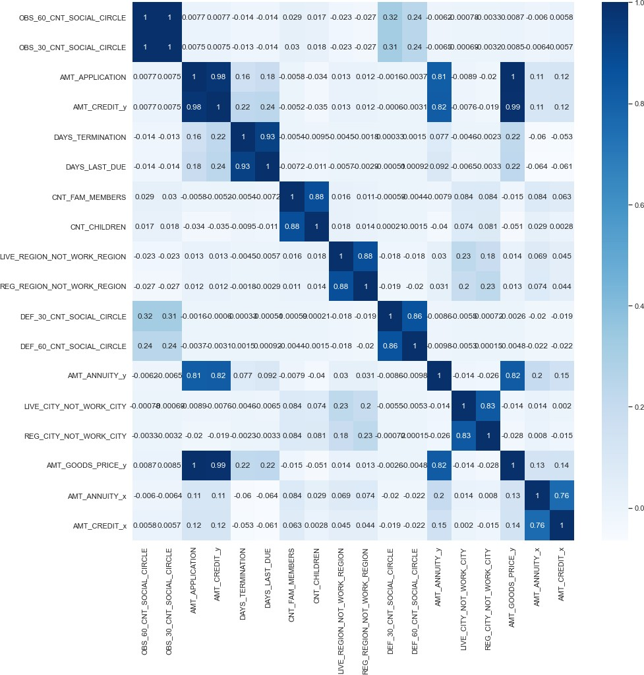
Adding the top10 correlated columns into a new dataframe:
Inferences
1. In comparison to the repayer heatmap, AMT_GOODS_PRICE and AMT_APPLICATION have a high correlation here as well, which means the more credit the client asked for previously is proportional to the goods price that the client asked for previously. 2. In comparison to the repayer heatmap, AMT_ANNUITY and AMT_APPLICATION also have a high correlation, which means the higher the loan annuity issued, the higher the goods price that the client asked for previously. 3. In comparison to the repayer heatmap, If the client's contact address does not match the work address, then there's a high chance that the client's permanent address also does not match the work address. 4. Higher the goods price, higher the credit by the client 5. First due of the previous application is highly correlated with Relative to the expected termination of the previous application (same as with the repayer heatmap) 6. CNT_CHILDREN and CNT_FAM_MEMBERS are highly correlated which means a client with children is higly likely to have family members as well (same as with the repayer
heatmap)

Slide 44
Conclusion from the Analysis
Banks must target more on contract type ‘Student’ ,’Pensioner’ and ‘Businessman’ for profitable business
Banks must focus less on income type ‘Working’ as it is has most number of unsuccessful payments in oreder to get rid of financial loss for the organization
Clients who are Students, Pensioners and Commercial Associates with a housing type such as office/co-op/municipal apartments NEED TO BE TARGETED by the bank for successful repayments. These clients have the highest amount of repayment history.
Female clients on maternity leave should NOT be targeted as they have no record of repayments (therefore they are highly likely to default and targeting them would lead to a loss)
While clients living with parents have the least amount of repayers, they also have the least amount of defaulters. So, in cases where the risk is less, such clients can be TARGETED.
Clients who are working need to be targeted LESS by the bank as they have the highest amount of defaulters.
Clients should NOT be targeted based on their education type alone as the data is very inconclusive.
Banks SHOULD target clients who own a car.
There are NO repayers/negligible repayers when the contract type is of revolving loan.
Banks SHOULD target more people with no children.
'Repairs' purpose of loan is the one with the most defaulters and repayers. Therefore, clients with very low risk SHOULD be given loans for such purpose to yield high profits.
Banks SHOULD also target female clients as they are the highest repayers (almost as double as males) amongst both the genders.

